Slide 1
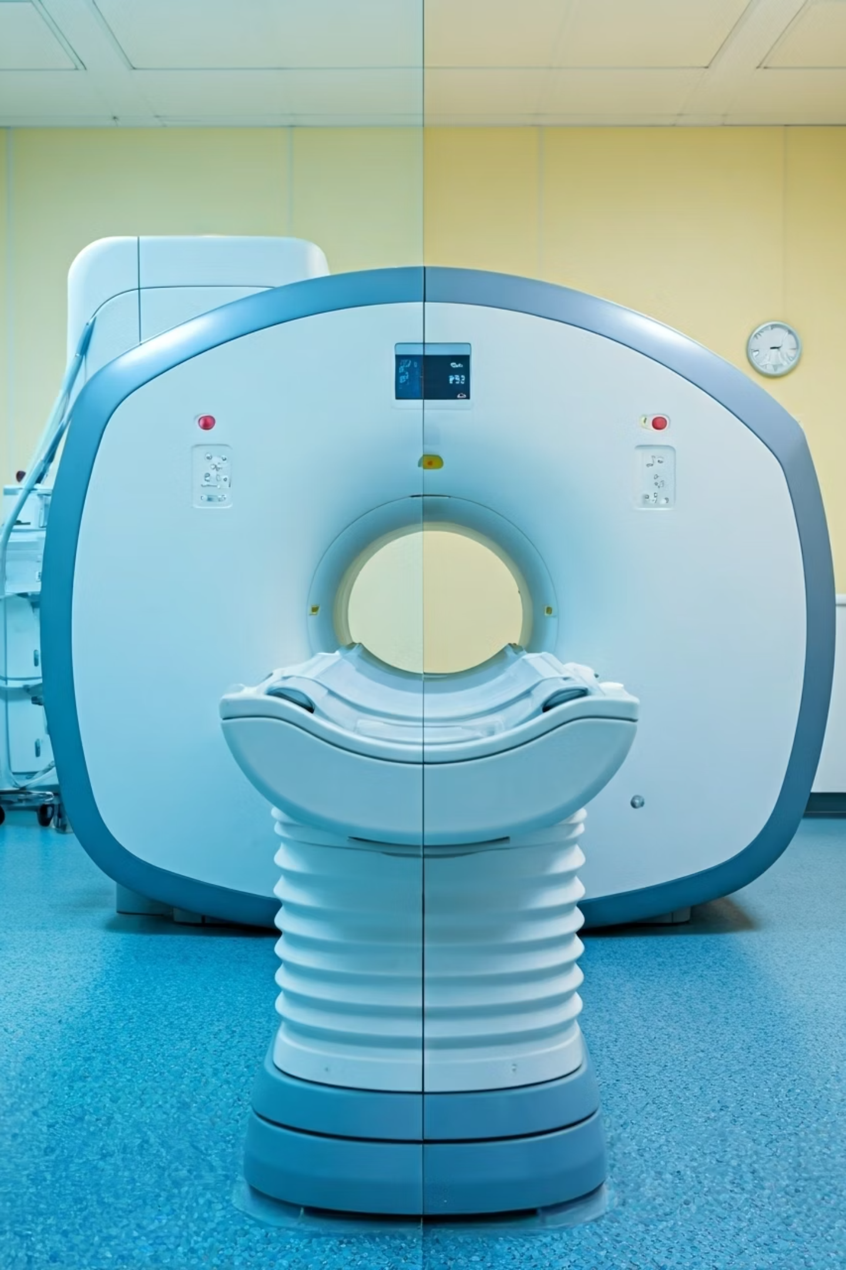

MRI Scan vs CT Scan – Explained for Beginners
Doctors use MRI scans and CT scans to take detailed pictures inside your body.
Both help find health problems like tumors, injuries, or infections, but they are different in how they work and what they are best for.
by Ram N Java

Slide 2
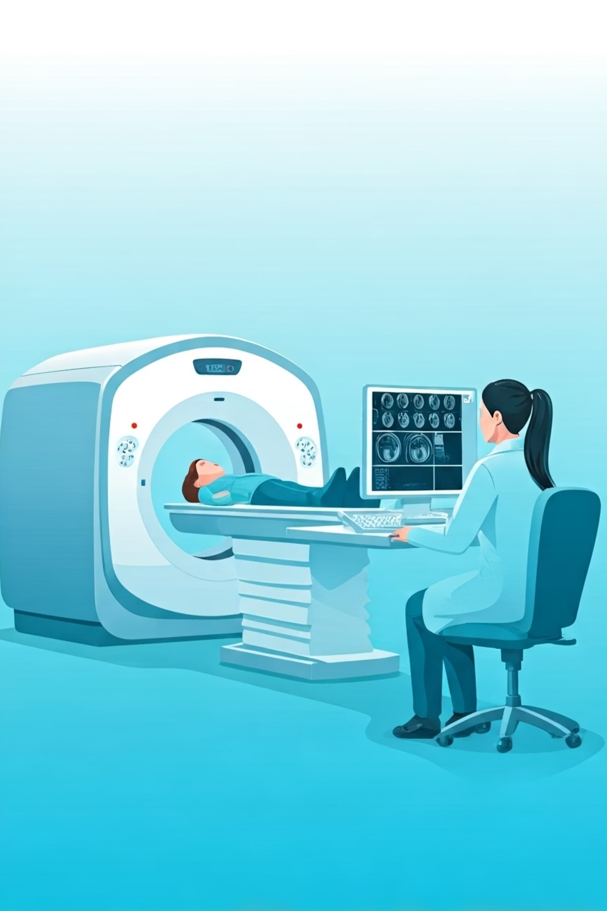
What is a CT Scan?
A CT Scan uses X-rays to take many pictures of your body from different angles.
A computer joins these pictures to make a 3D image.
It is quick and used often for bones, chest, abdomen, and injuries.

Slide 3
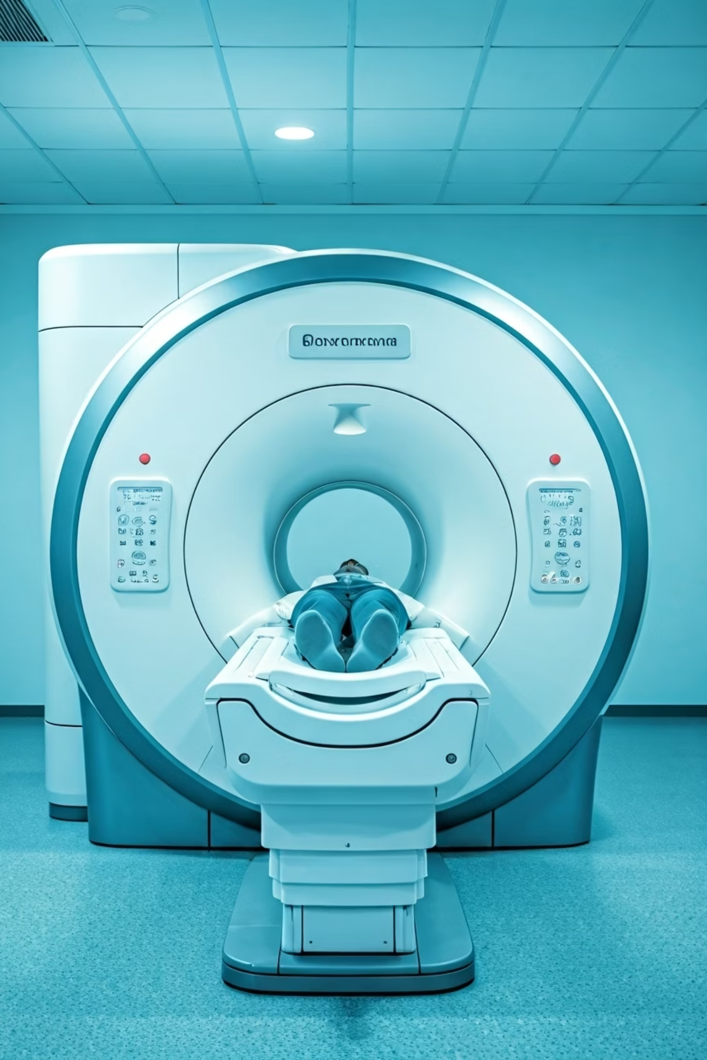
What is an MRI Scan?
An MRI Scan uses strong magnets and radio waves to take pictures of the inside of your body.
It does not use X-rays.
It shows soft tissues like the brain, muscles, heart, and spinal cord more clearly than a CT scan.

Slide 4
Main Differences Between MRI and CT Scan
Feature
CT Scan
MRI Scan
Technology
Uses X-rays
Uses magnets and radio waves
Radiation
Yes
No
Best for
Bones, chest, injuries, bleeding
Brain, nerves, muscles, organs
Scan time
10–15 minutes
30–45 minutes or more
Noise level
Less noisy
Loud knocking sounds
Comfort
Open ring, more space
Long tunnel, can feel tight
Metal in body
Usually safe
Not safe if you have metal implants
Cost
Usually less expensive
Usually more expensive

Slide 5

Which one is better?
CT Scan is better when:
MRI Scan is better when:
You need a quick test
You need to see soft tissues like the brain, spinal cord, or joints
Checking for bone fractures, bleeding, or lung issues
You want to avoid radiation

Slide 6

Are they safe?
Yes, both are safe when used properly by doctors.
CT scans use a small amount of radiation.
MRI scans are safe for most people, but not if you have metal implants (like pacemakers).

